Slide 2
Company Name: Center-Installation-Energy LLC
Name of presenter: Mila Rudenko
Position of presenter: Manager in
public relations

Slide 3
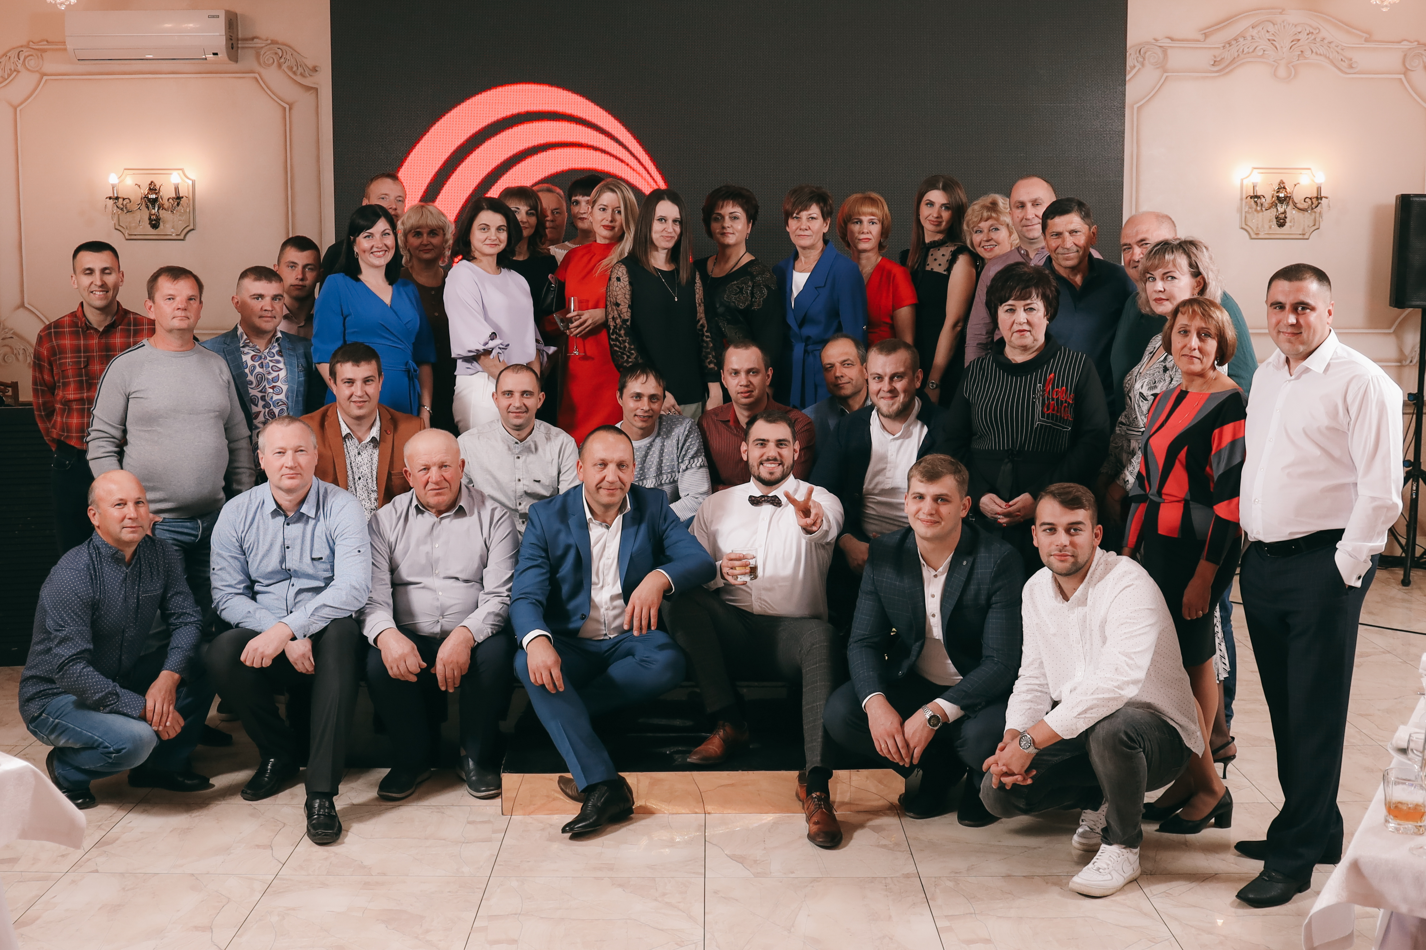
Who we are?
Main markets: Ukraine, neighbouring countries of Ukraine, Europe, USA, etc
Annual turnover: € 1 297 840
Number of employees: 98
Location of production sites: 20300, Cherkasy region, Uman city, USPENSKA street, building 17
(We carry out work throughout Ukraine)
Examples of projects: Construction of power lines including transformer substations from geodesy to putting into service
Team Center-Installation-Energy LLC

Slide 4
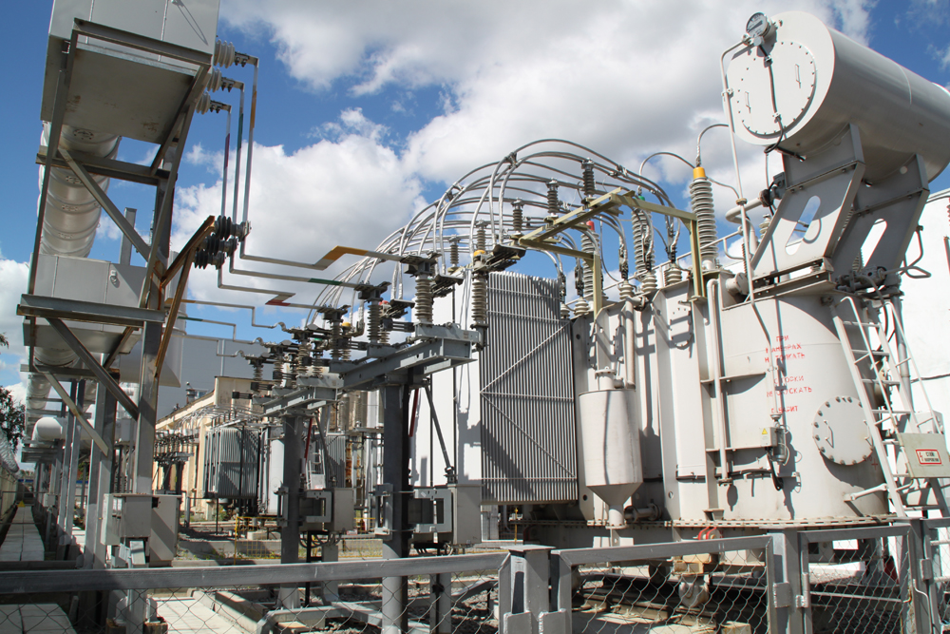
Who we are?
The company was founded in 2006.
Services provided by our company:
Our company carry out electrical installation works in electric installations up to 150 kV inclusive, wiring, commissioning and maintenance work, installation, and adjustment of devices of RP (Relay protection), and we are working with the construction of pipelines, we are carrying out works on reconstruction of existing water supply networks, heating, and air conditioning systems.
Carries out electrical measurements, revision and repairing, measurement and adjustment of safety valves. We have a moving measuring electrotechnical laboratory ETL (electrical laboratory) – 10 kV & ETL (electrical laboratory) – 35 kV.

Slide 5
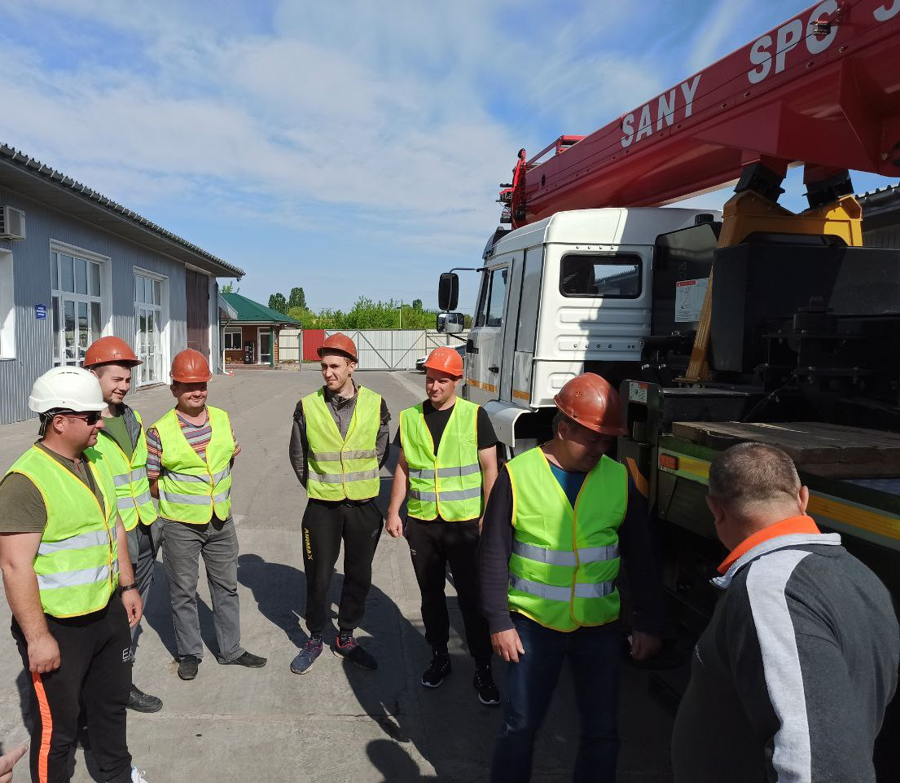
Who we are?
The company develops the design and budget documentation.
Provides architectural, engineering, geology, and geodesy services as well as other professional, scientific, and technical activity.
Prepares training for managers and employees of Ukrainian enterprises on occupational health and safety and trains employees in professional (vocational) solar power plants, reserve and emergency, power supply, energy storage systems on lithium batteries.

Slide 6
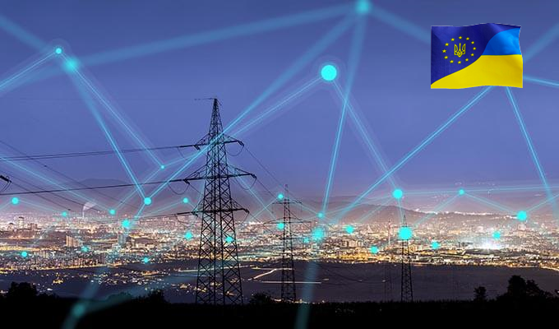
What do we look for
We are looking for an investor to finance the implementation of these services.
We are looking for partners who can help to restore Ukraine’s energy system integrated into the European space (Partners, Investors)

Slide 7
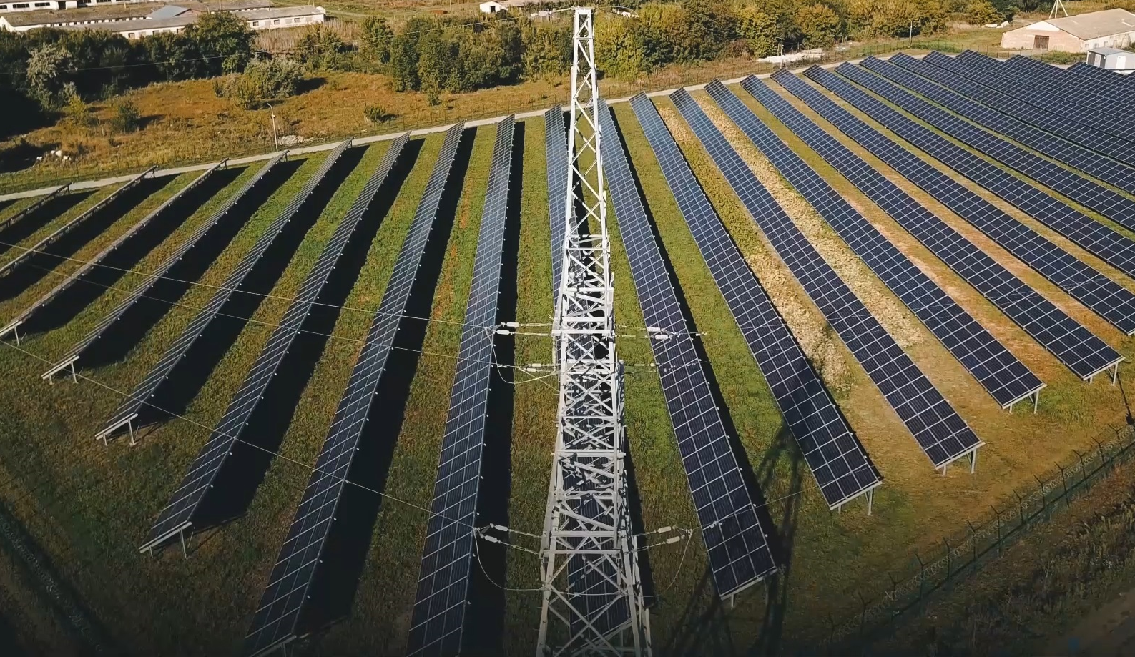
What do we look for
Type of technology/assets introduced by partner, it is innovative energy saving technologies and implemented alternative energy sources. (Personnel, facilities, equipment, training of these specialists, knowledge of Ukrainian legislation)
The partner/investor must work in energy sector.

Slide 8
What do we look for
We can offer our partner services market development, technology development and co-production.
We aim to such markets: European Union countries, Great Britain.
We are looking for an opportunity to expand the range of services with the participation of foreign partners and colleagues in the field of construction (turnkey) electrical networks with voltage up to 150 kV inclusive, including the construction of generating power plants from alternative power sources and solar radiation.

Slide 9
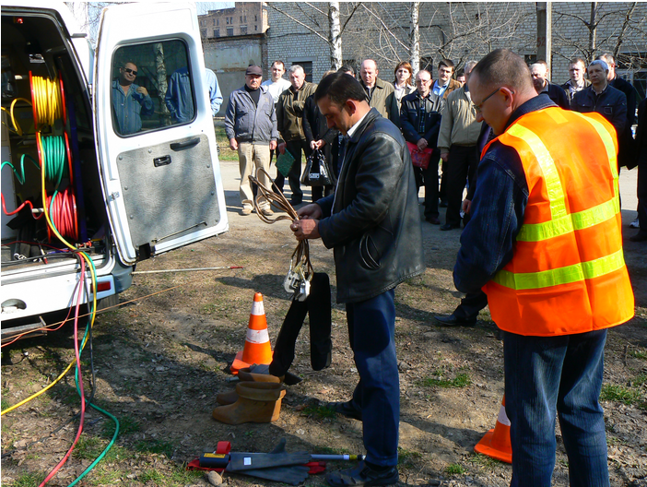
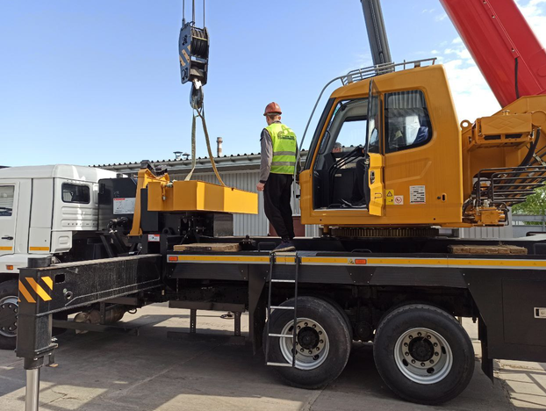
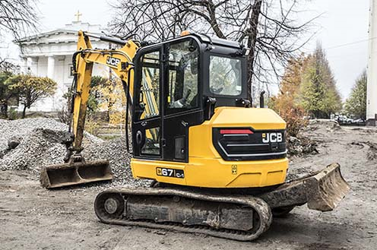
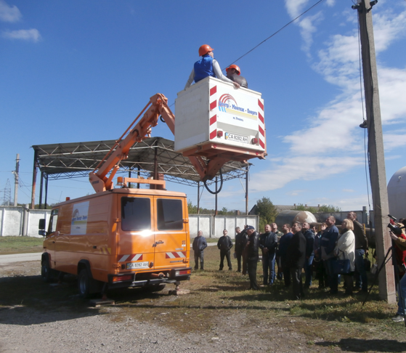
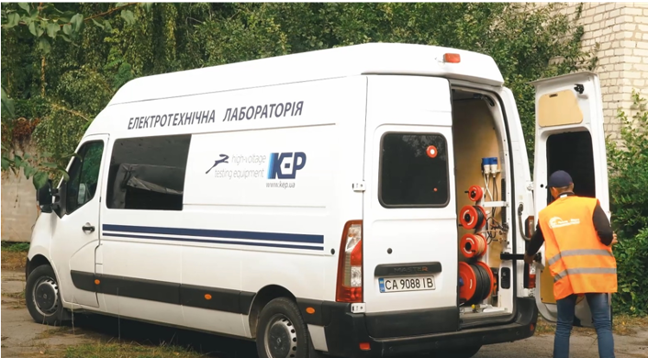
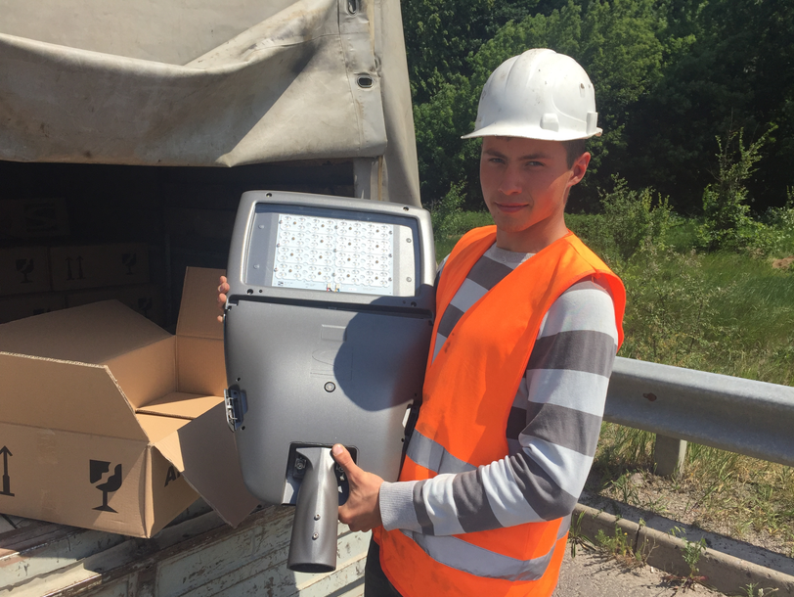

Slide 10
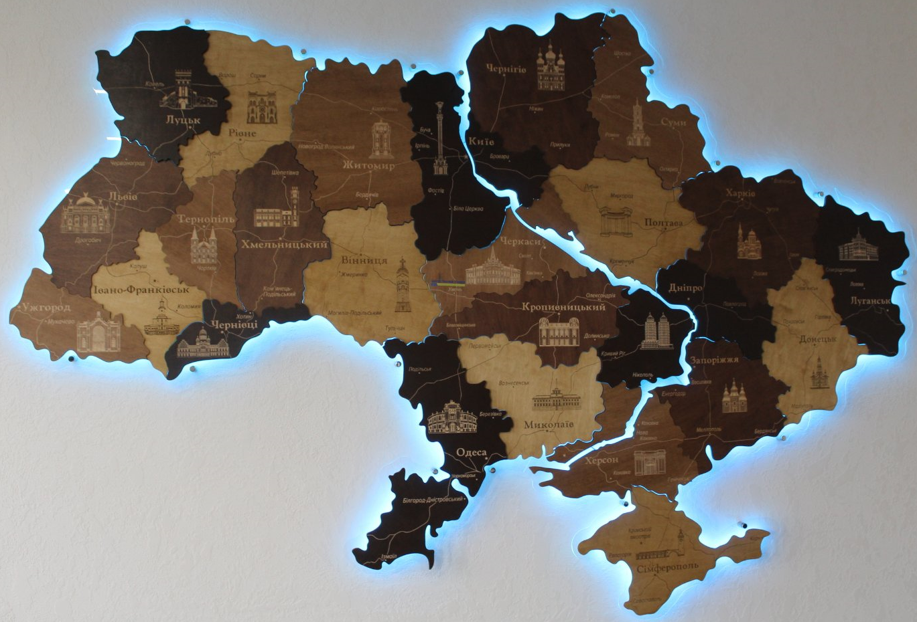
Three good reasons to work with us?
A company with more than 15 years’ experience with energy industry in Ukraine
A team of young and active professionals
Availability of equipment, warehouses, educational laboratories and workshops, our logistics location is the Center of Ukraine (near Kyiv)

Slide 11
CONTACTS
+38 (066) 03-91-367
cme.tender@ukr.net
http://c-m-energo.com.ua/
https://www.facebook.com/cmenergouman/friends_likes
20300, Cherkasy region, Uman city, USPENSKA STREET, building 17

